Slide 1
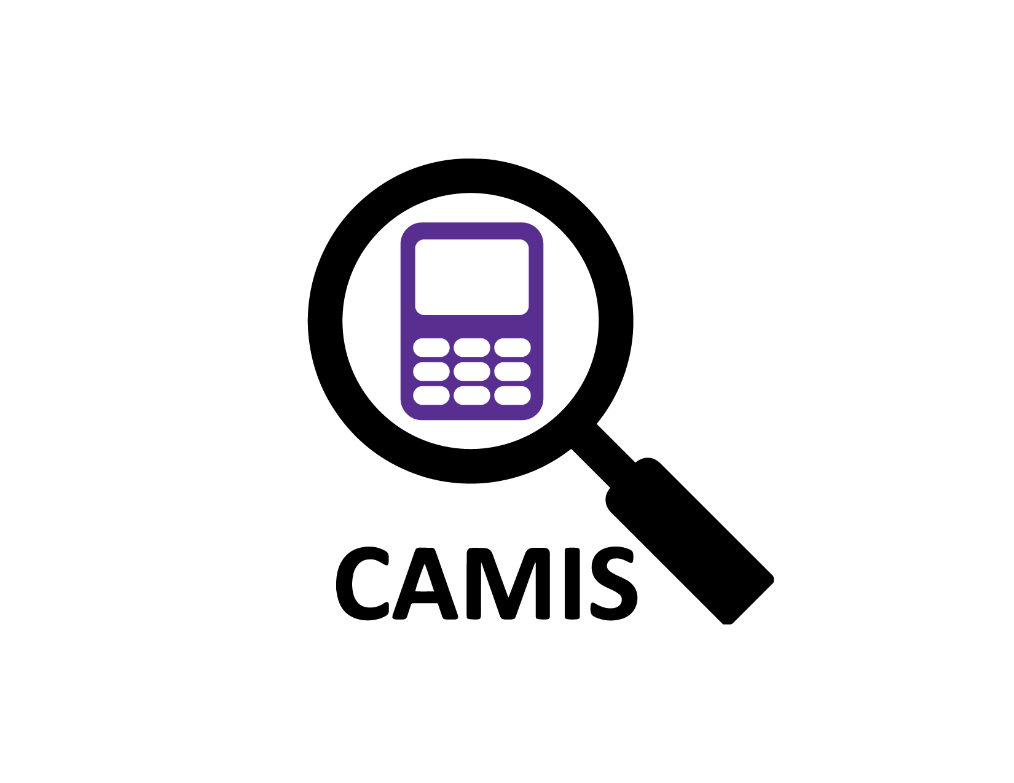
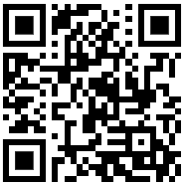
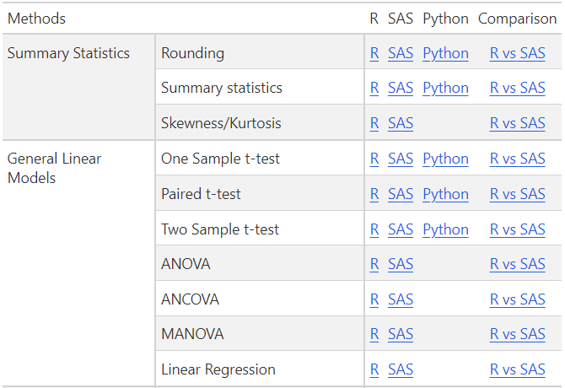

Comparing Analysis Method Implementations in Software WG
Project Objectives
To increase understanding and awareness of analysis result discrepancies across software (R, SAS, Python etc)
To demonstrate the methodology through examples
To document in open GitHub repository
To grow the repository, increasing quality and quantity of information
To join us, just fork the repo and start your contributions or contact lyn.taylor@parexel.com or christina.e.filmore@gsk.com for more information

